Slide 1
DESIGN PROCESS

Slide 2
UNIT - 4
UI Design Process
Task Oriented Design
Object Oriented Design
CSCW UI Design
Case Studies.

Slide 3
UI DESIGN PROCESS

Slide 4
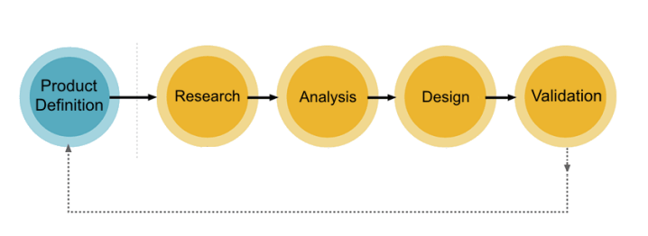
5 STEPS OF UI/UX DESIGN PROCESS
The entire UI/UX design process can be divided into 5 phases.
The responsible department will be analyzing every single step, and make it almost perfect!

Slide 5
PRODUCT DEFINITION
The team responsible for this will collect the user requirements based on their business environment. It’s very much essential because understanding about the real scope of the product and their existence happens in this phase.
It’s simple; before beginning the work, enlighten your UI/UX designers about the requirements!
People involved in this phase are Design Team, Business Manager, and Product Manager. The entire team should consult with clients in their environment. Analyze their needs within the framework of your operation.

Slide 6

PRODUCT DEFINITION
The significant outcomes of this phase are User Personas, User Stories, and Use Case Diagrams.

Slide 7
RESEARCH
The research is the most crucial element for a designer.
The designing team studies how the present system works for the current client proposal.
The three main functions at this stage are:
Have an understanding of the competition.
Making a thorough study of your existing domain.
Going through competitor strategy to test outcomes.

Slide 8
ANALYSIS
In this phase, make use of the things collected in the Research phase. With the help of the information received, create hypothetical personas, and experience maps.
Hypothetical Personas:
Creating hypothetical scenarios help the designers to know about the various persons who will be the users of your product.
It allows depicting the realistic representation of the ultimate product.
The design team can figure out how it is going to look like after delivery.
Experience Maps:
Experience maps shows the user flow within your final product.
All these are done using visual representations through proper interactions with the client in the product definition phase.

Slide 9
DESIGN
In the design process, we finally end up giving life to ideas that we have collected in the above three steps.
The design team will execute the final design in this phase.
The significant outcomes of the designing phase are:
Sketching
Creating wireframes
Creating Prototypes
Creating Design Specifications

Slide 10
VALIDATION OR TESTING
Testing is the phase that determines the overall quality of the end- product.
The testers make notes of the things that have to be improved and send them back to the respected team for correcting the errors.
While evaluating your final product, there are certain factors that one needs to keep in mind.
Is the system user-friendly?
Is it flexible and easy to operate?
Does it solve the customer’s issue?
Is it credible and attracts the users to come back every time they need your service?

Slide 11
TASK ORIENTED APPROACH

Slide 12
TASK ORIENTED APPROACH
It involves the understanding of user tasks, and their sequencing of user actions.
There are 7 stages of task oriented approach.

Slide 13
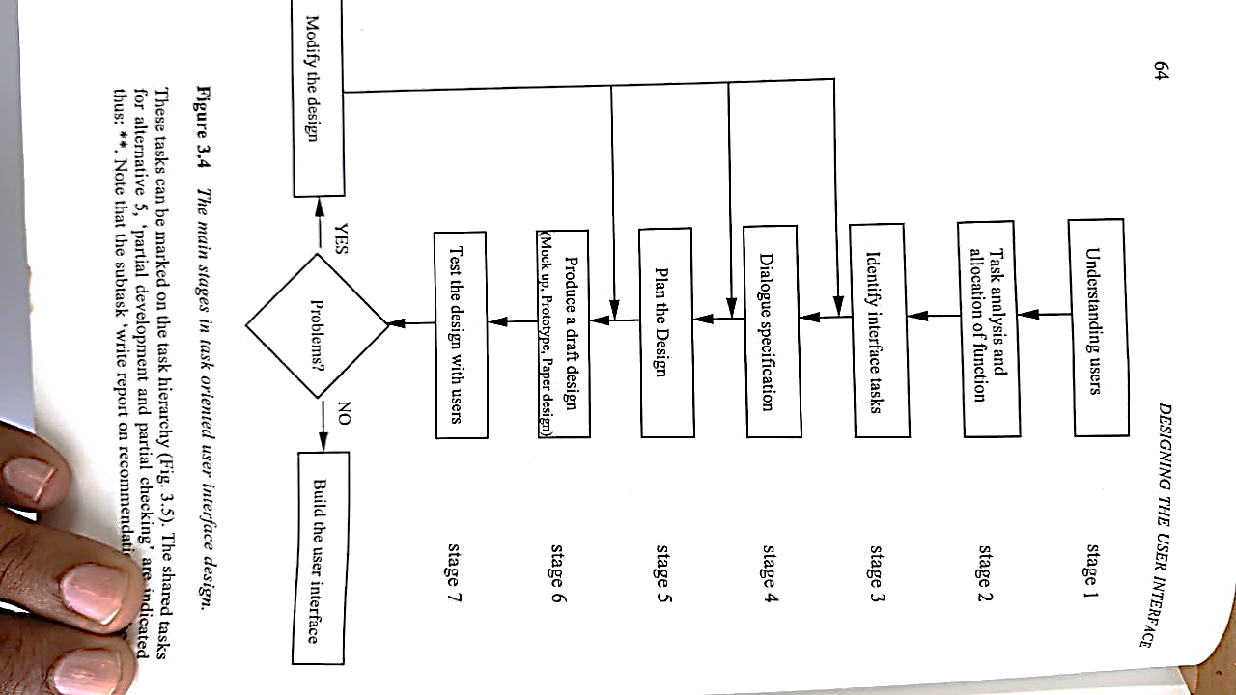
TASK ORIENTED APPROACH

Slide 14
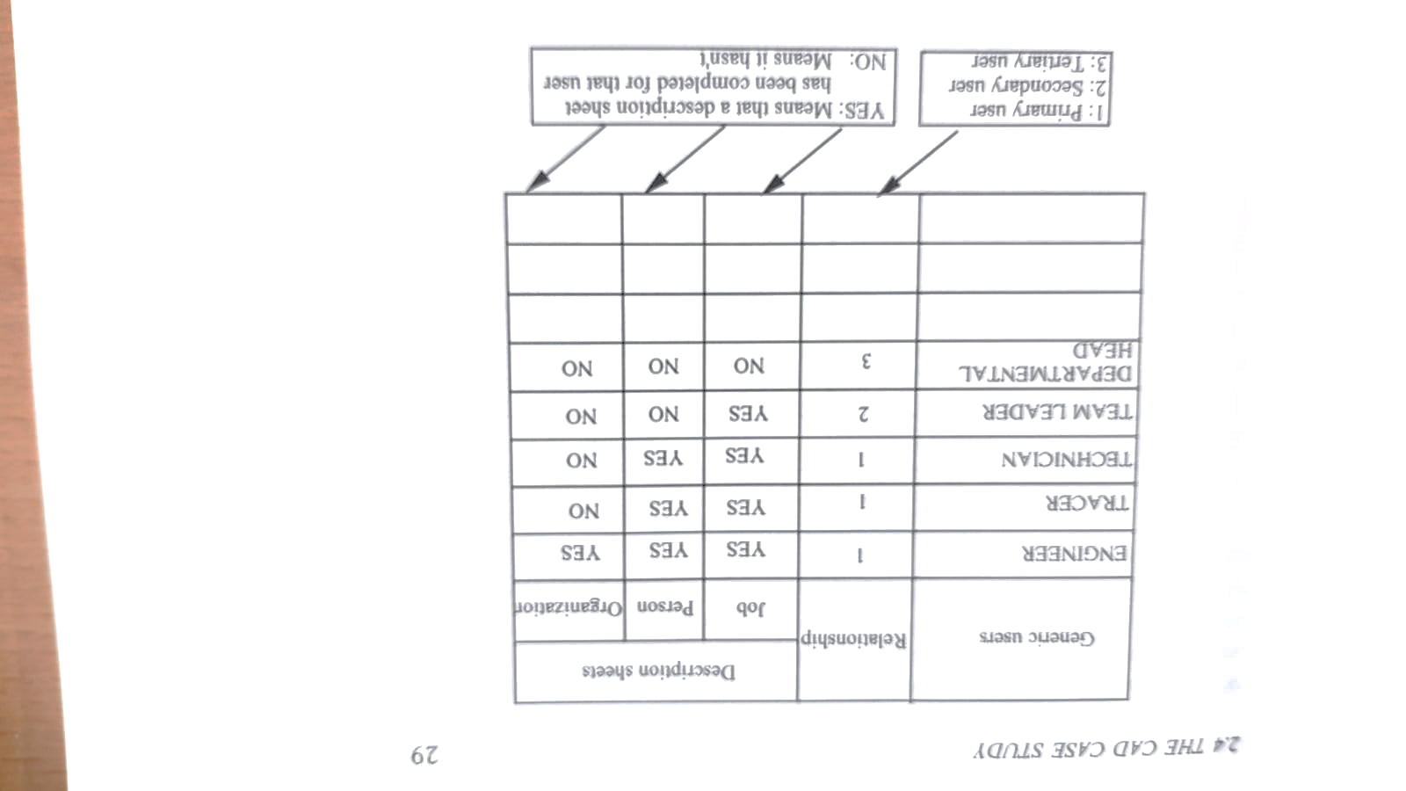
STAGE – 1 – UNDERSTANDING USERS

Slide 15
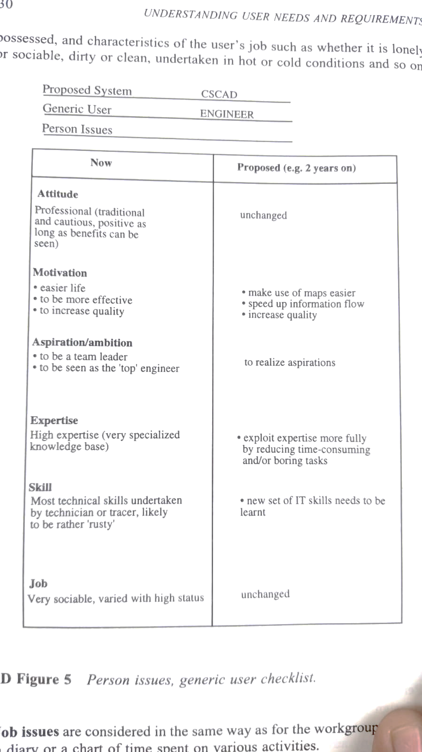
STAGE – 1 – UNDERSTANDING USERS

Slide 16
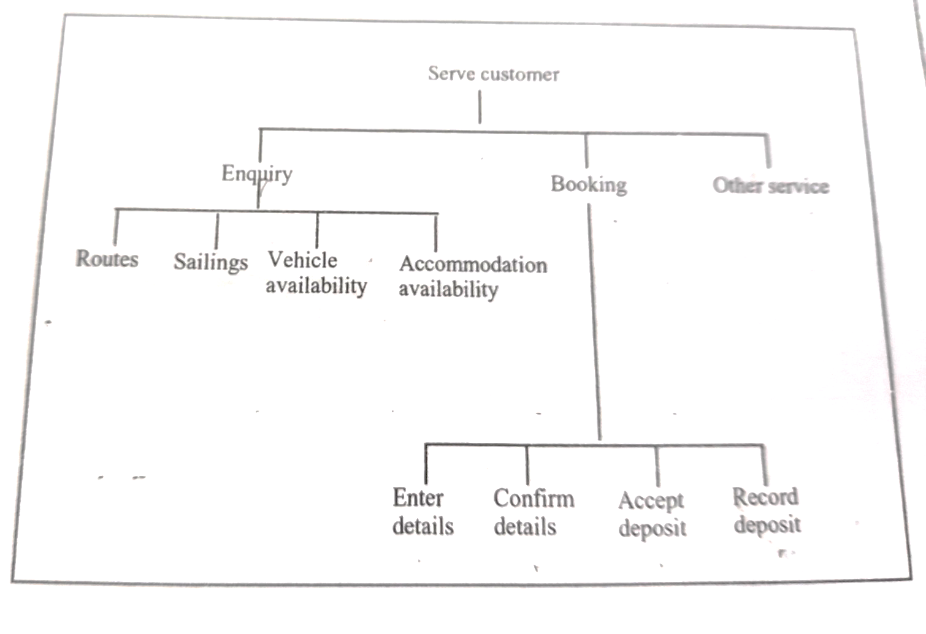
STAGE – 2 –TASKS ANALYSIS AND ALLOCATION OF FUNCTION

Slide 17
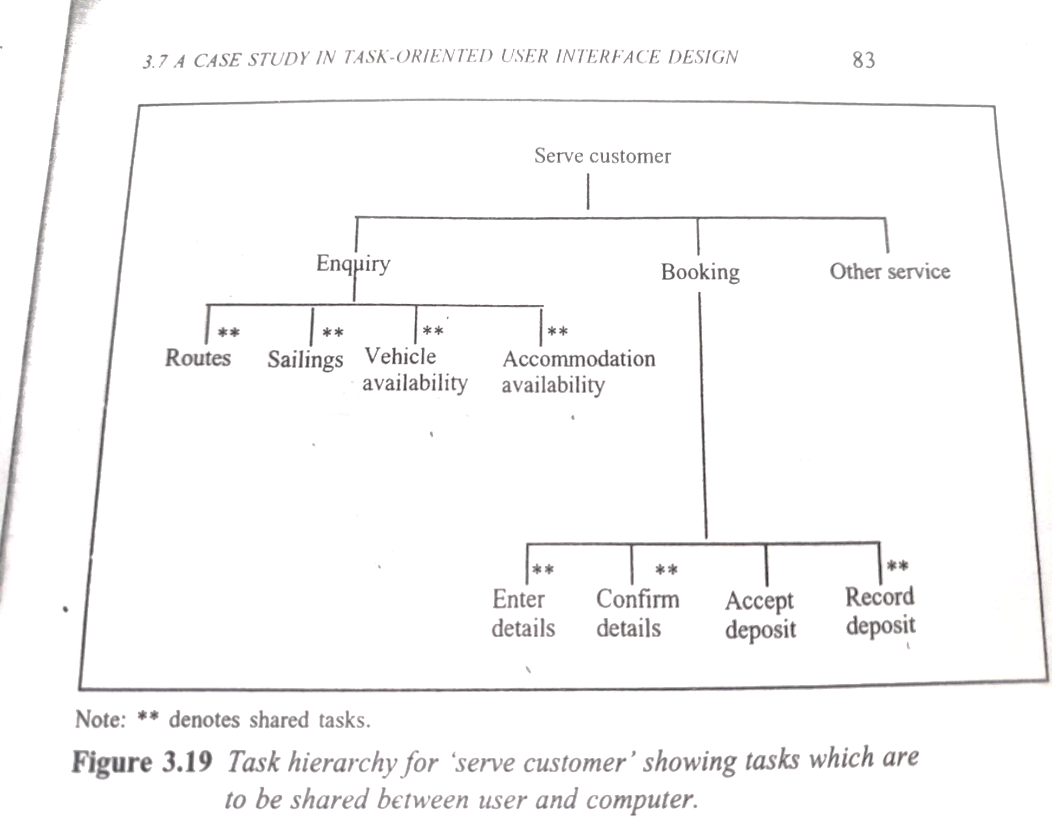
STAGE – 3 – IDENTIFY SHARED TASKS
THOSE SYSTEMS WHICH ARE SHARED BETWEEN USER AND SYSTEM WILL HAVE A USER SYSTEM INTERFACE

Slide 18
STAGE – 4 – SPECIFY USER SYSTEM DIALOGUE
Two techniques for specifying the dialogue between user and system is introduced.
Dialogue Network diagram
Logical Dialogue Controls (LDC)

Slide 19
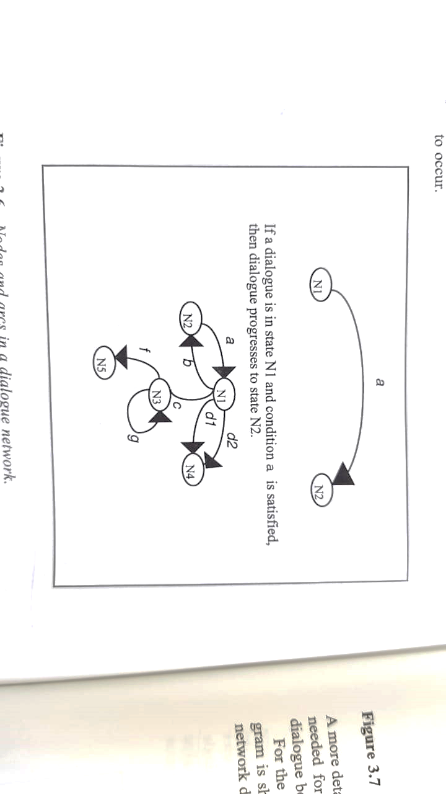
STAGE – 4 – SPECIFY USER SYSTEM DIALOGUE
DIALOGUE NETWORK DIAGRAM

Slide 20
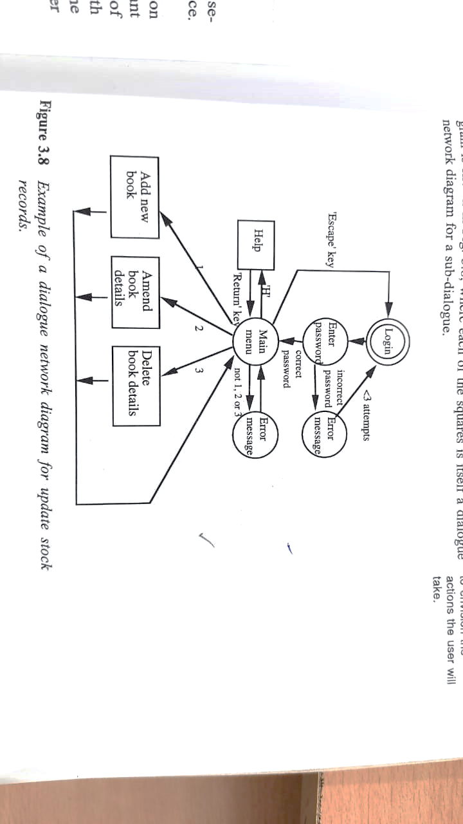
STAGE – 4 – SPECIFY USER SYSTEM DIALOGUE

Slide 21
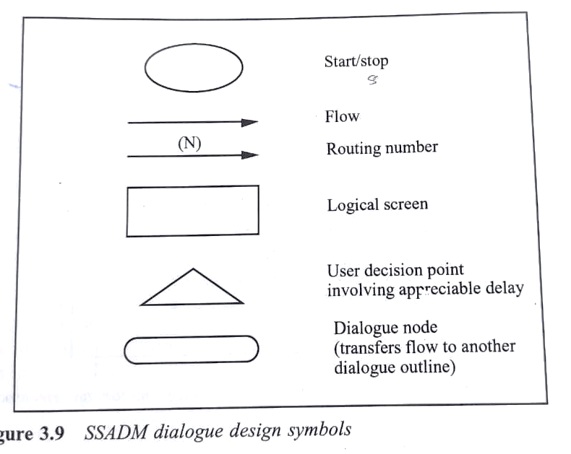
STAGE – 4 – SPECIFY USER SYSTEM DIALOGUE
Logical Dialogue Controls (LDC)

Slide 22
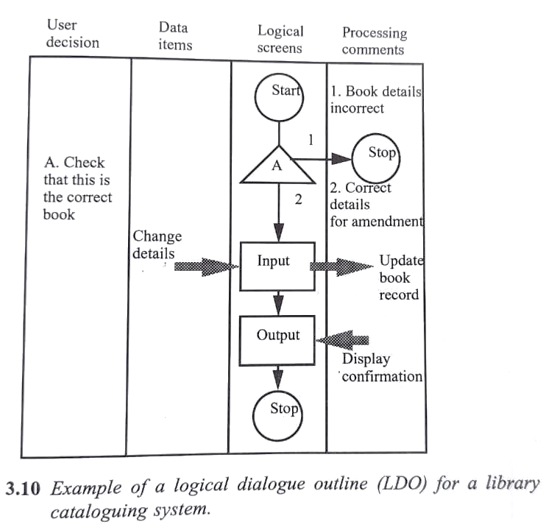
STAGE – 4 – SPECIFY USER SYSTEM DIALOGUE

Slide 23
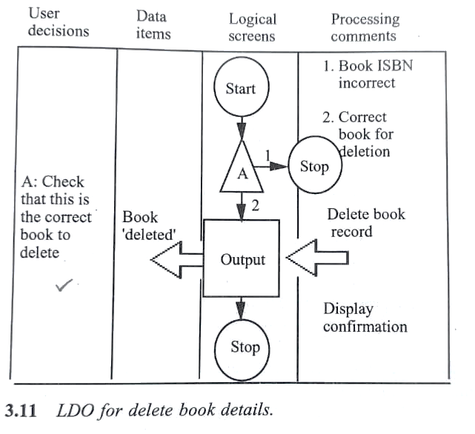
STAGE – 4 – SPECIFY USER SYSTEM DIALOGUE

Slide 24
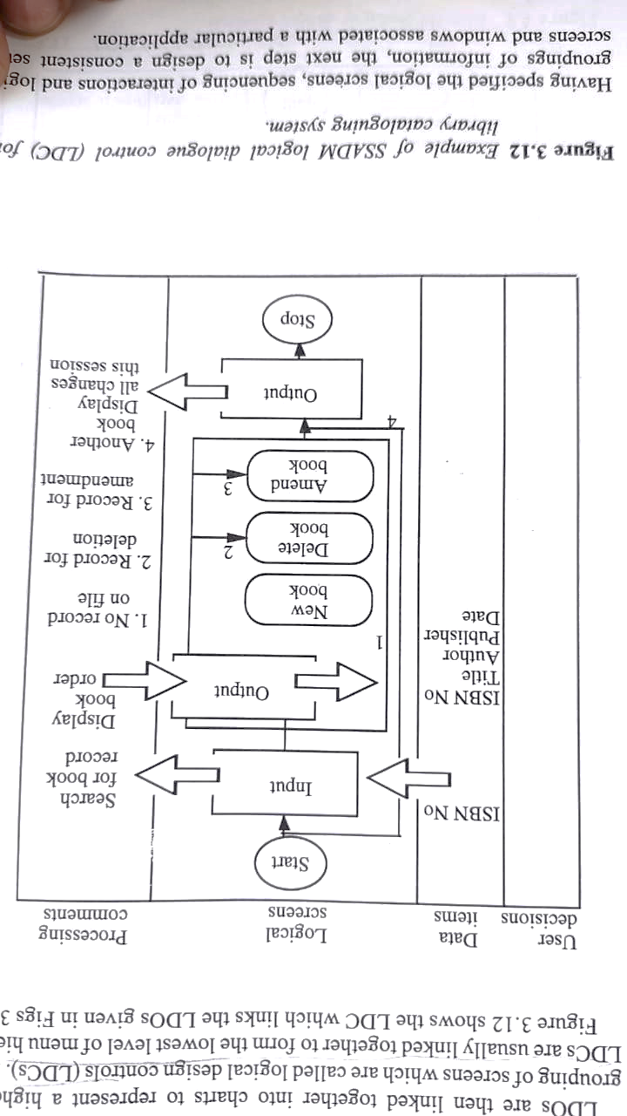
STAGE – 4 – SPECIFY USER SYSTEM DIALOGUE

Slide 25
STAGE – 5 – PLAN THE DESIGN OF USER INTERFACE
Planning is divided into four main stages.
Deciding what information should be displayed in each window
Deciding how the information should be displayed
Deciding where each field will appear
Deciding what highlighting is required.

Slide 26
What information should be displayed in each window
Follow the guidelines in menu design
How the information should be displayed
Follow the guidelines of information presentation
Follow the guidelines on data entry
Where should the information be displayed.
Follow the guidelines on positioning of text
Follow the guidelines in presentation of text
Follow the guidelines in design of windows
When to use highlighting.

Slide 27
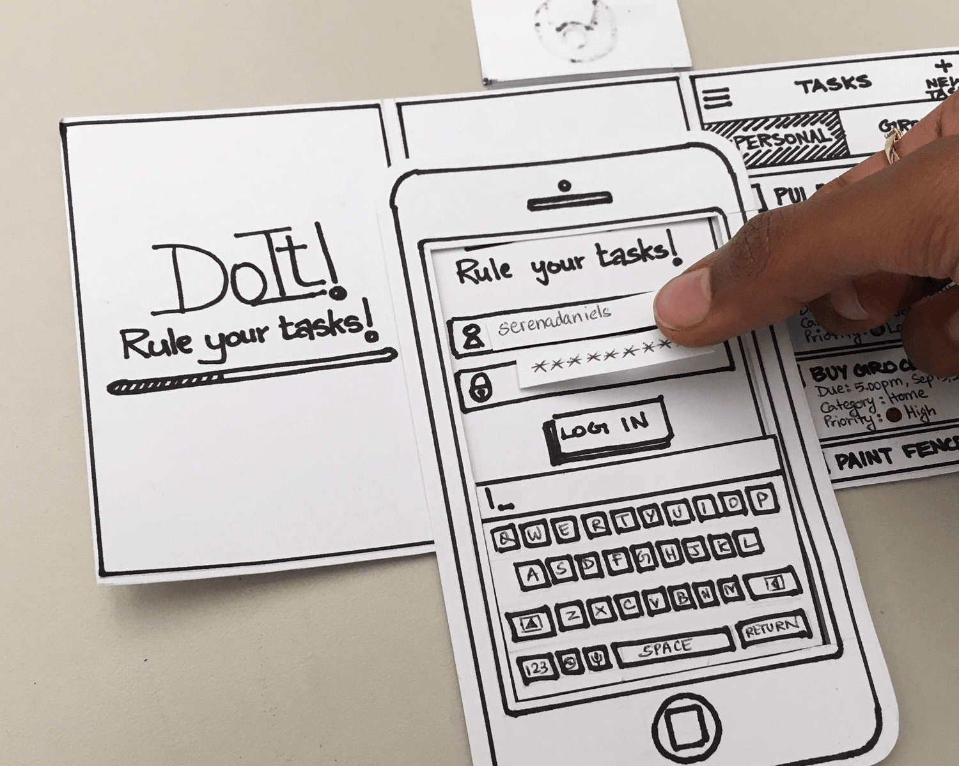
STAGE – 6 – PRODUCE A DRAFT DESIGN
Use screen layout sheets, screen design aids, paper mock-ups or prototyping tools to produce a first draft.

Slide 28
STAGE – 7 – TEST THE DESIGN WIT USERS
Evaluate the layout in terms of design principles.
Then evaluate the effectiveness of the design through the experimentation with target users.

Slide 29
CASE STUDY

Slide 30
FAST FERRARI RESERVATION SYSTEM
Stage – 1 – understanding users
Business Case
Work group table
Workgroup: Sales staff: Job issues
Generic User: Travel agent: Person issue
Task: Enquiry: Organization Issue
Task: Booking: Organization Issue
Users, Object, task: Travel agent, Voyage details, Enquiry
Users, Object, task: Travel agent, Booking details, Booking

Slide 31
FAST FERRARI RESERVATION SYSTEM
Stage – 2 –tasks analysis and allocation of function
Task analysis
Allocation of function
Stage – 3 – identify shared tasks
Stage – 4 – Specify User System Dialogue
Dialogue Network Diagram

Slide 32
FAST FERRARI RESERVATION SYSTEM
Stage – 5 – Plan the Design of User Interface
Full Screen Window template
Error popup window template
Stage – 6 – Produce a draft design
Main Menu
Some Enquiry Window
Some Booking Window
Stage – 7 – Test the design wit users

Slide 33
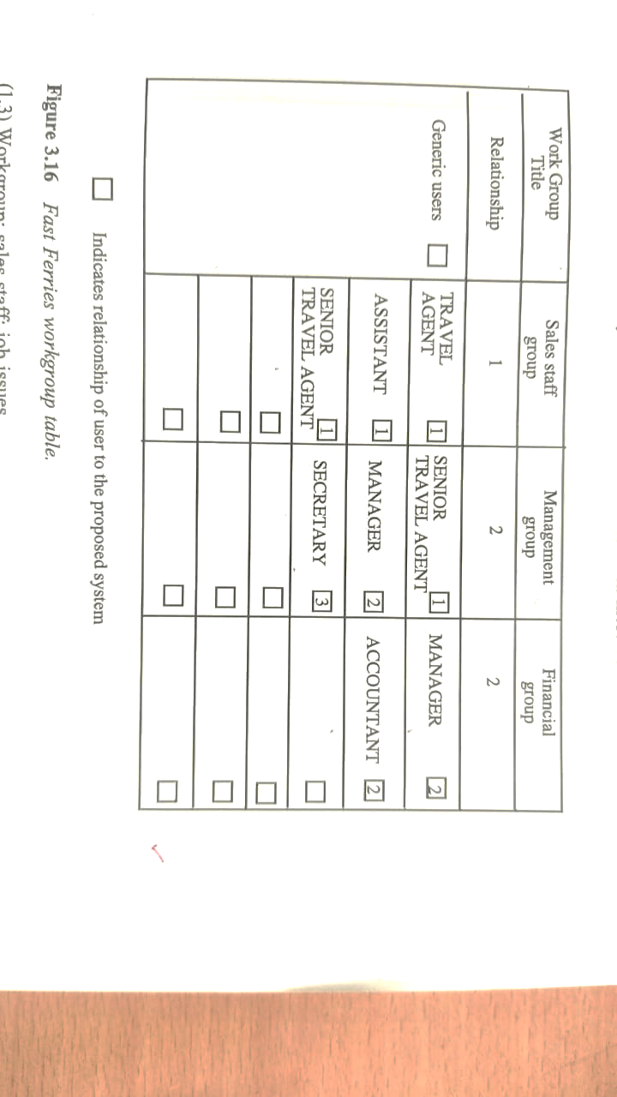
WORK GROUP TABLE

Slide 34
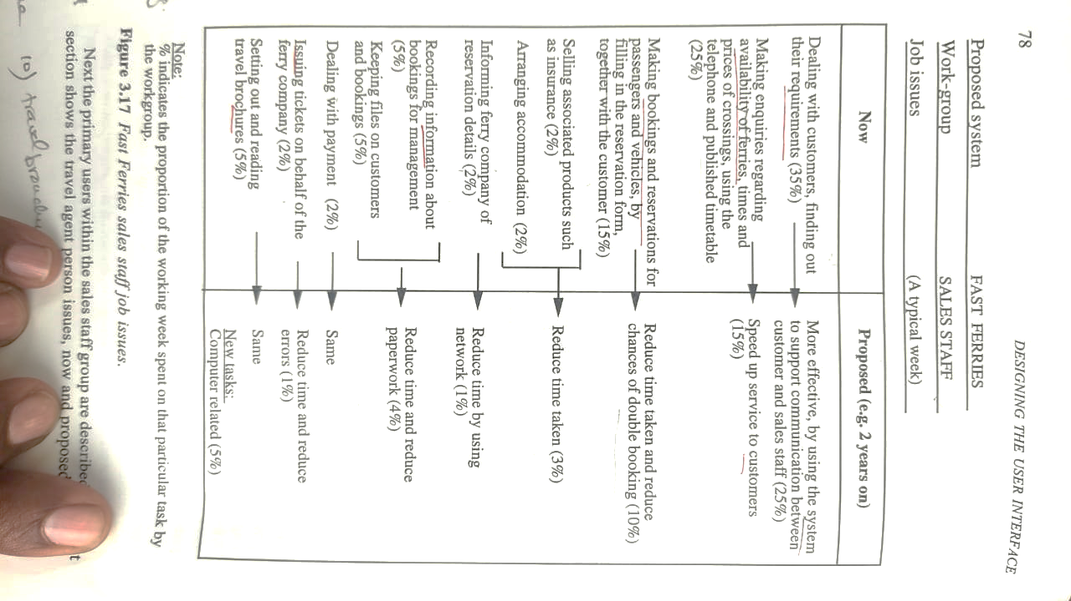
WORKGROUP: SALES STAFF: JOB ISSUES

Slide 35
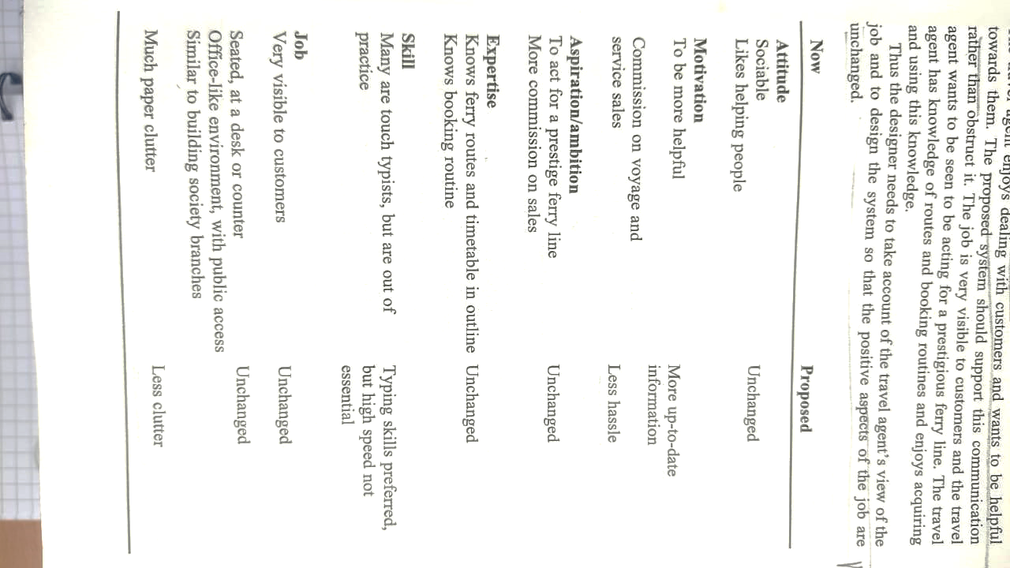
GENERIC USER: TRAVEL AGENT: PERSON ISSUE

Slide 36
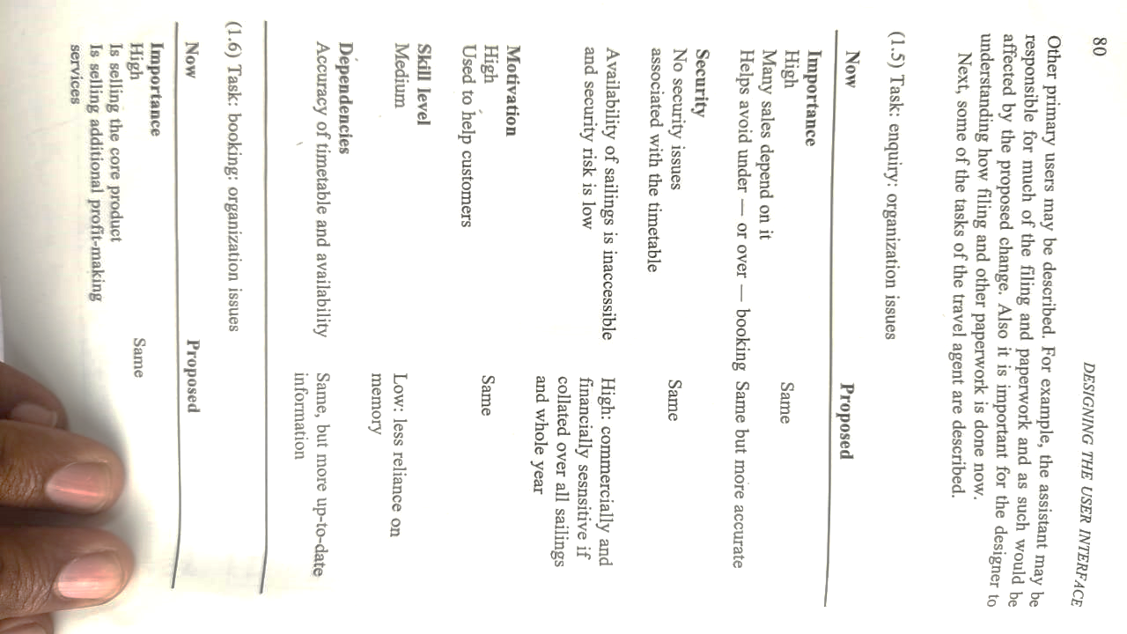
TASK: ENQUIRY: ORGANIZATION ISSUE

Slide 37
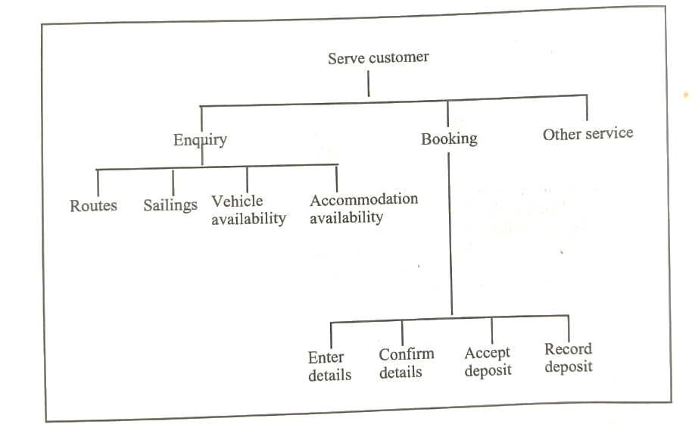
STAGE – 2 –TASKS ANALYSIS AND ALLOCATION OF FUNCTION

Slide 38
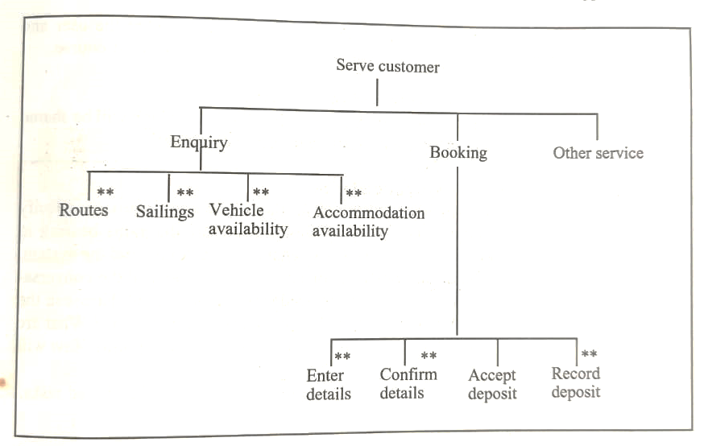
STAGE – 3 – IDENTIFY SHARED TASKS

Slide 39
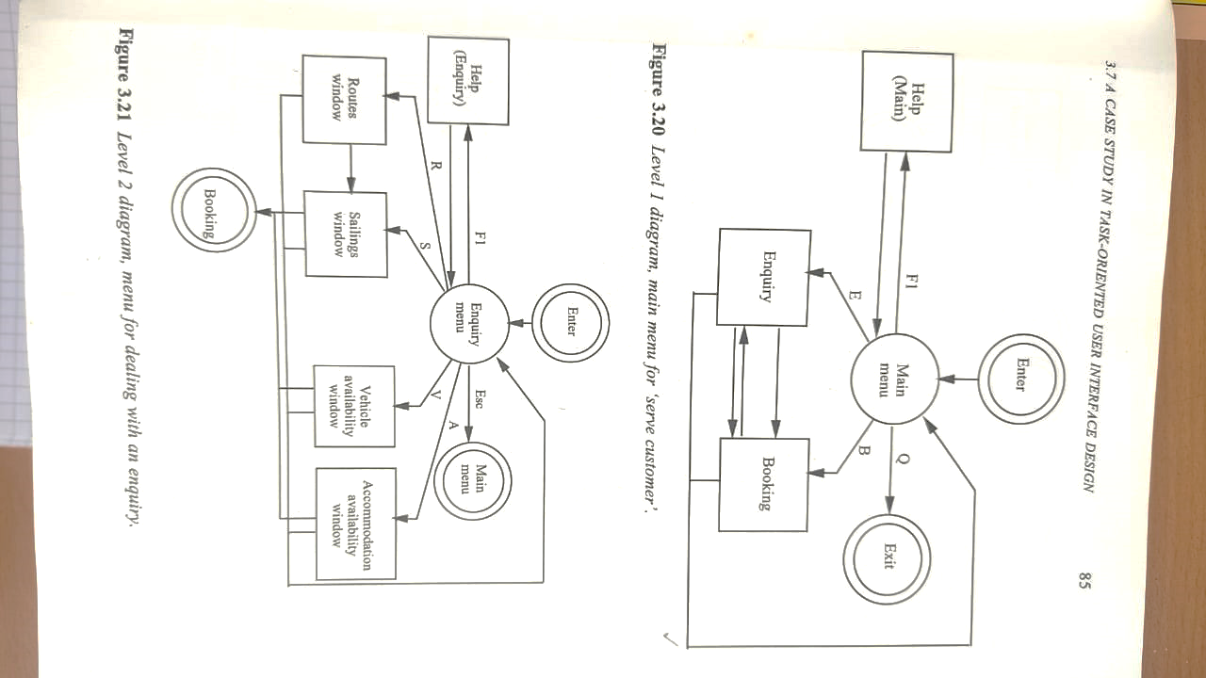
STAGE – 4 – SPECIFY USER SYSTEM DIALOGUE

Slide 40
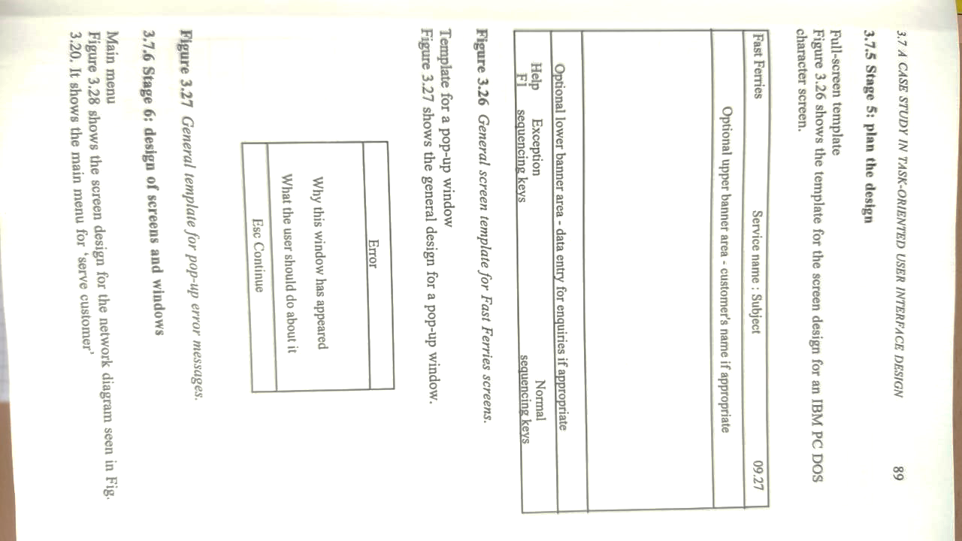
STAGE – 5 – PLAN THE DESIGN OF USER INTERFACE

Slide 41
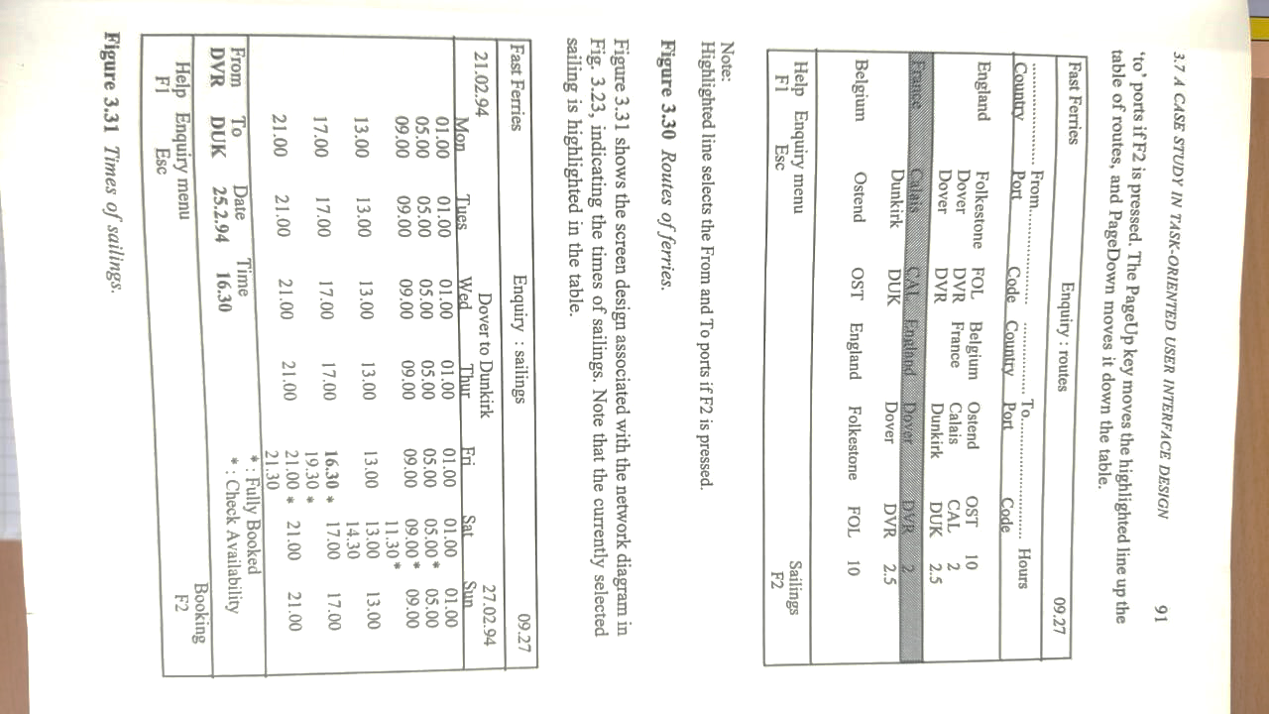
STAGE – 6 – PRODUCE A DRAFT DESIGN

Slide 42
STAGE – 6 – PRODUCE A DRAFT DESIGN

Slide 43
OBJECT ORIENTED APPROACH

Slide 44
OBJECT ORIENTED APPROACH
GUIs use an object action paradigm where the user indicates an object first and then decide the action.

Slide 45
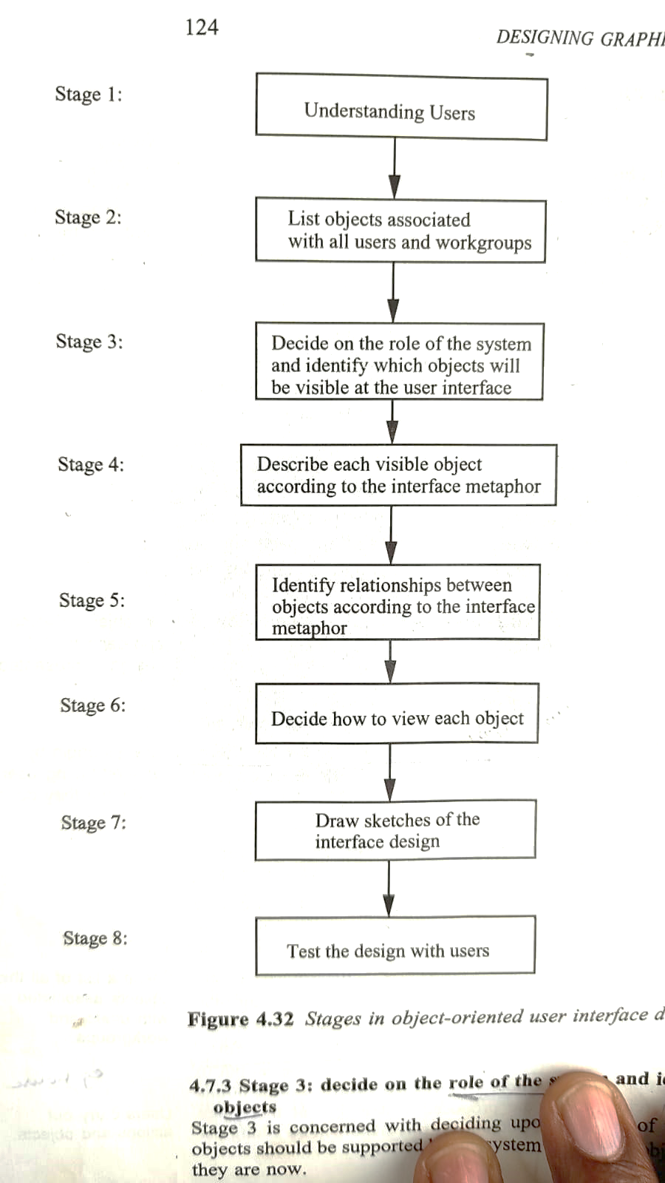

Slide 46
STAGES IN OBJECT ORIENTED APPROACH
Stage:1 – Understanding the users
This stage will provide the description of what the do now and a basis for identifying objects.
Always begin by understanding the users and what they do.

Slide 47
STAGES IN OBJECT ORIENTED APPROACH
Stage:2 – List Objects associated with all users and workgroup
Different users will carryout different actions on the same object.
Make a list of all objects associated with users and workgroup.
These tasks should be set out in a list for each workgroup and all the nouns underlined.

Slide 48
STAGES IN OBJECT ORIENTED APPROACH
Stage:3 – Decide on the role of the system and identify visible objects
Decide the role of the system.
Classify the objects [Eg: Objects are automated (i.e., Invisible), Visible UI, External system object]
Identify aggregations, different names and reports.
Revised List of Objects

Slide 49
STAGES IN OBJECT ORIENTED APPROACH
Stage:4 – Describe each visible objects
Now and Proposed descriptions
Descriptions according to metaphor adopted

Slide 50
STAGES IN OBJECT ORIENTED APPROACH
Stage:5 – Identify relationship between objects
The nature of relationship will also depend on the interface metaphor adopted.
Relationship such as association and containment shall be identified.
This stage involves understanding how the user will interact with the system.

Slide 51
STAGES IN OBJECT ORIENTED APPROACH
Stage:6 – Decide how to view each objects
Views of objects are decided
Icons
Menubars
Menu Items,
Forms

Slide 52
STAGES IN OBJECT ORIENTED APPROACH
Stage:7 – Draw the Sketches of the Interface Design
Draw the Sketches of the Interface Design and discuss possible scenarios of use with the users.
Should not spend too much time on drawing a draft of the design.

Slide 53
STAGES IN OBJECT ORIENTED APPROACH
Stage:8 – Test the Design with users
User reactions are sought concerning the choices of objects, the views of each object.
The design should be modified to reflect user reactions.

Slide 54
CASE STUDY

Slide 55
FAST FERRARI RESERVATION SYSTEM
STAGE:1 – UNDERSTANDING THE USERS

Slide 56
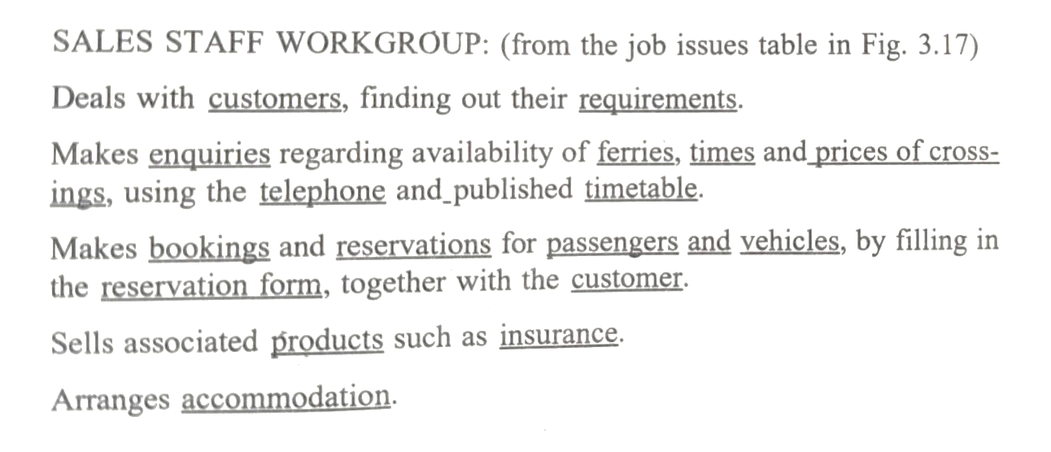
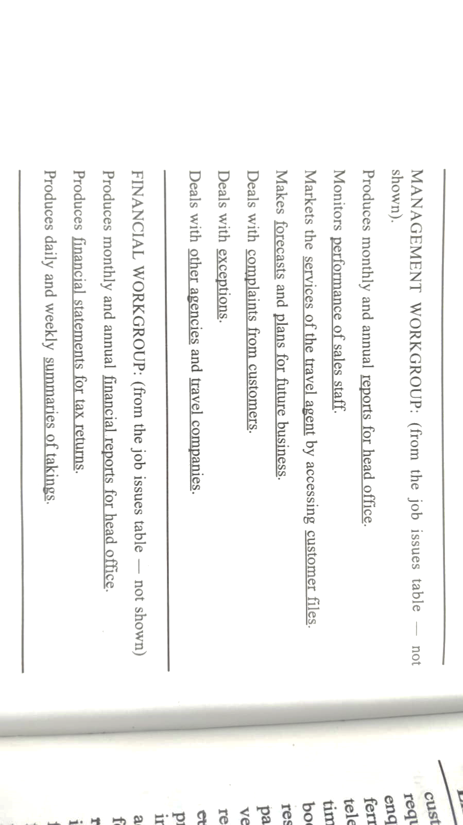
FAST FERRARI RESERVATION SYSTEM
Stage:2 – List Objects associated with all users and workgroup

Slide 57
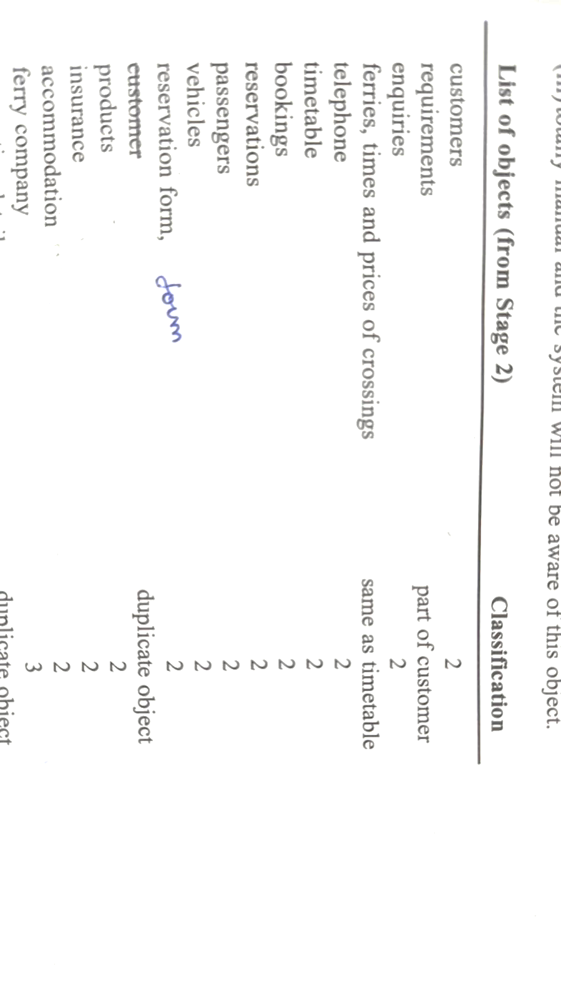
FAST FERRARI RESERVATION SYSTEM
Stage:3 – Decide on the role of the system and identify visible objects

Slide 58
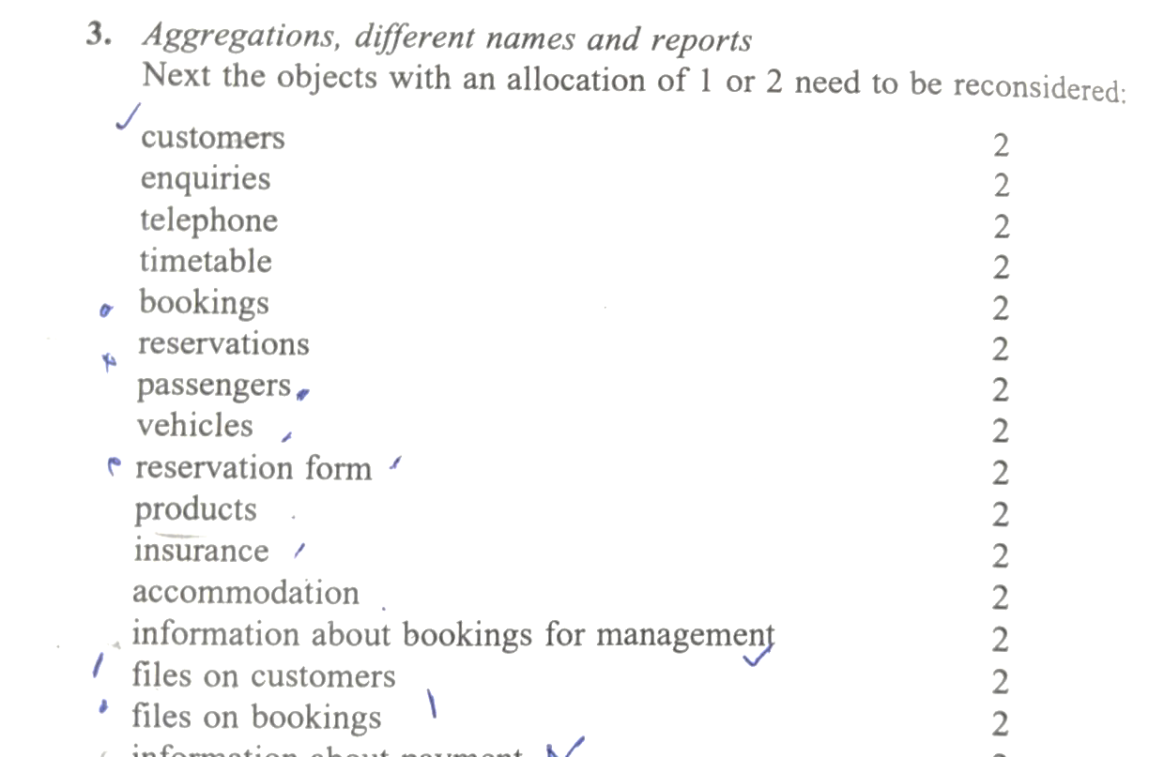
FAST FERRARI RESERVATION SYSTEM
Stage:3 – Decide on the role of the system and identify visible objects

Slide 59
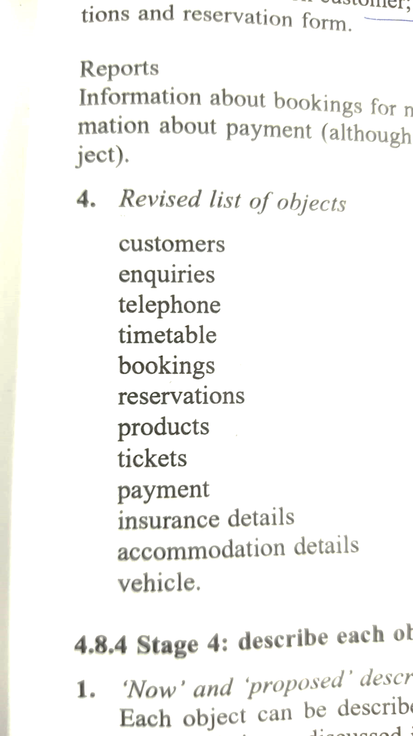
FAST FERRARI RESERVATION SYSTEM
Stage:3 – Decide on the role of the system and identify visible objects

Slide 60
FAST FERRARI RESERVATION SYSTEM
Stage:4 – Describe each visible objects
What is it?
Who has access to the object?
Who is responsible for the management of the object?
What is it?
What is its representation and quality?

Slide 61
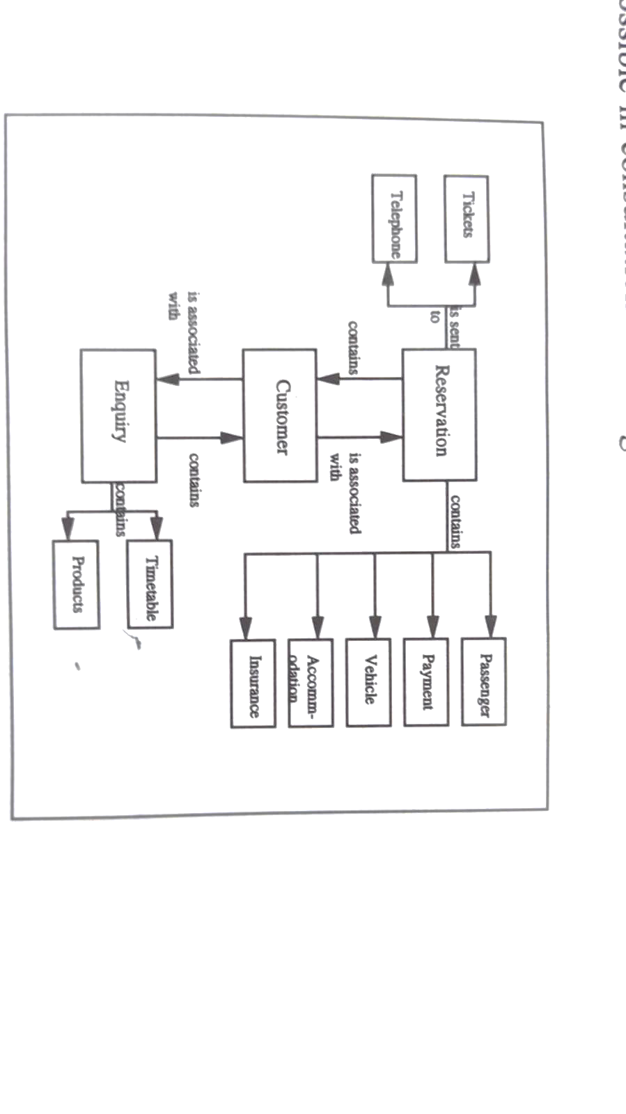
FAST FERRARI RESERVATION SYSTEM
Stage:5 – Identify relationship between objects

Slide 62
FAST FERRARI RESERVATION SYSTEM
Stage:6 – Decide how to view each objects
The reservation, Customer Enquiry may be viewed as an Icons.
On selection of reservation, the menu bar will appear containing the passenger details.

Slide 63
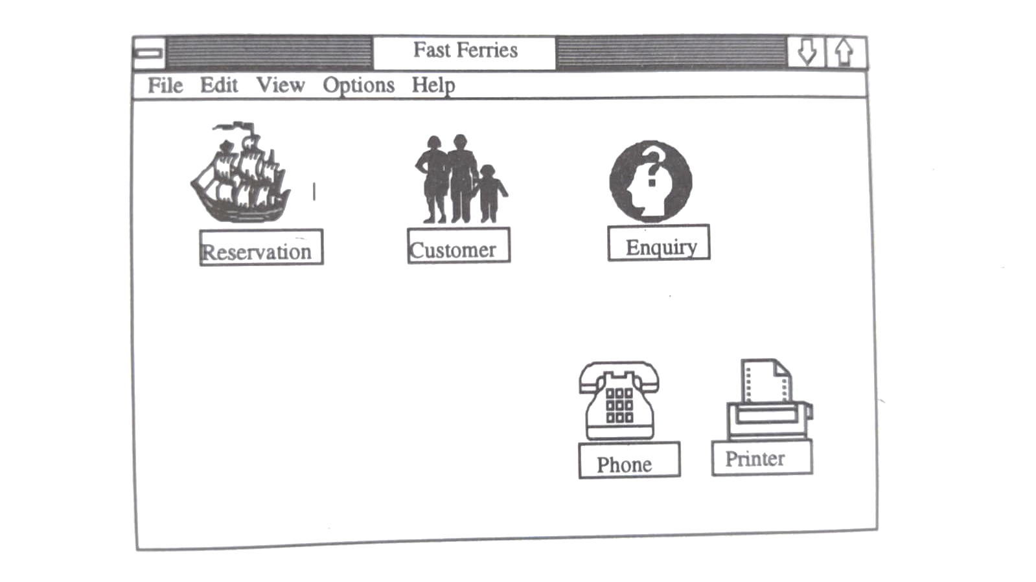
FAST FERRARI RESERVATION SYSTEM
Stage:7 – Draw the Sketches of the Interface Design

Slide 64
FAST FERRARI RESERVATION SYSTEM
Stage:8 – Test the Design with users
Designers simply show the screen design to potential users and discuss a typical scenario of use with them

